Slide 1
OpenRefine Basics
Using OpenRefine to explore and clean data

Slide 2
OpenRefine
What is it?
Why use it?
Open Source
Great tool
Especially for cleaning data
Students love it!
Great workflow
Filter → Transform
Easy to Use
Most action through menus
Powerful
Scripting under the hood

Slide 3
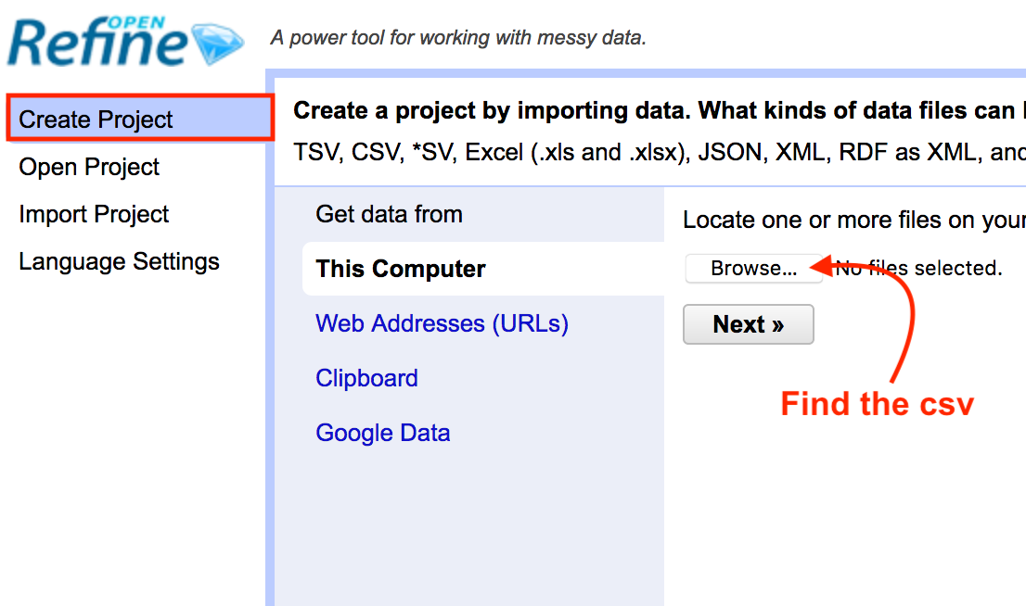
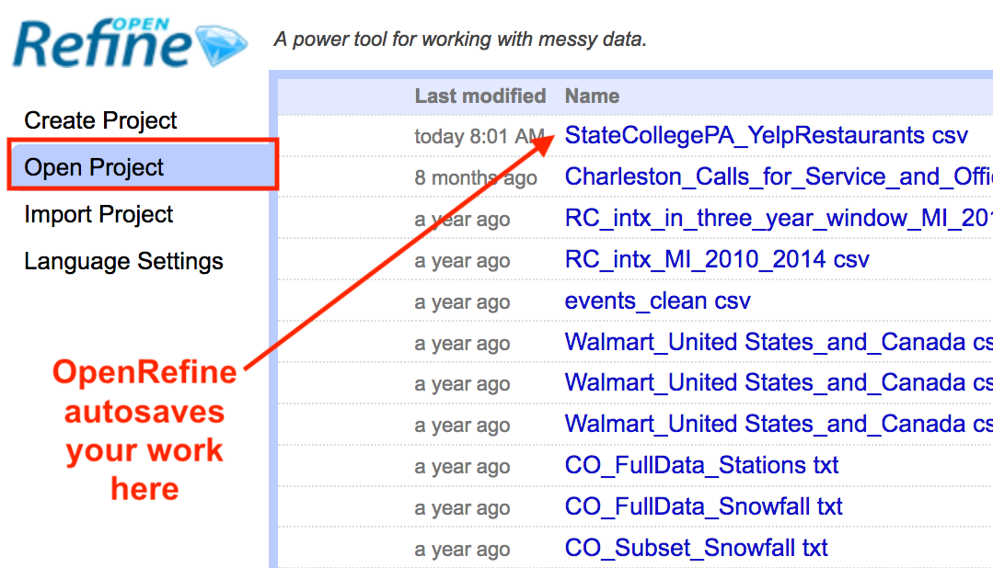
Getting Started
Open a New File
Continue with an Old Project

Slide 4

Malone wants dinner! Exercise 1 – Start a Project
Start OpenRefine and …
Create Project → Get Data from this Computer →Choose Files
Locate the file StateCollegePA_YelpRestaurants.csv
Find if here
Click Next
Let’s Eat!

Slide 5
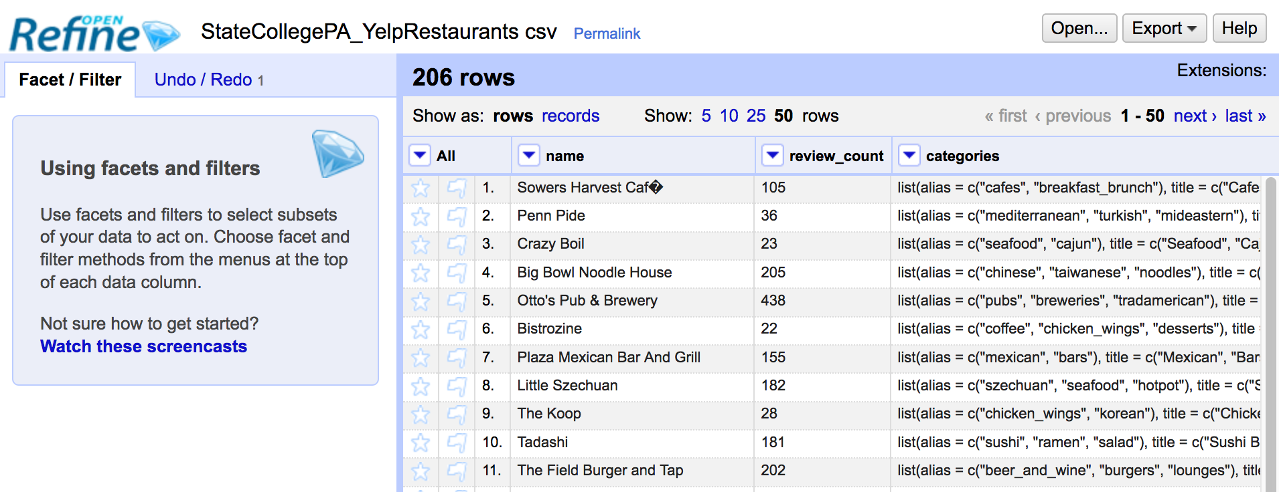
Basic Layout

Slide 6
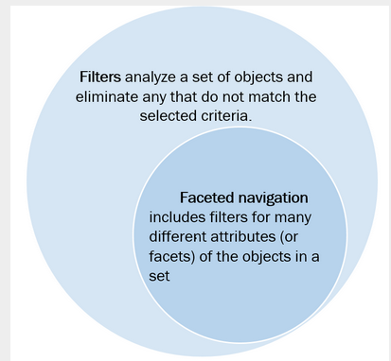
Filters and Facets
Image Source: https://www.nngroup.com/articles/filters-vs-facets/

Slide 7

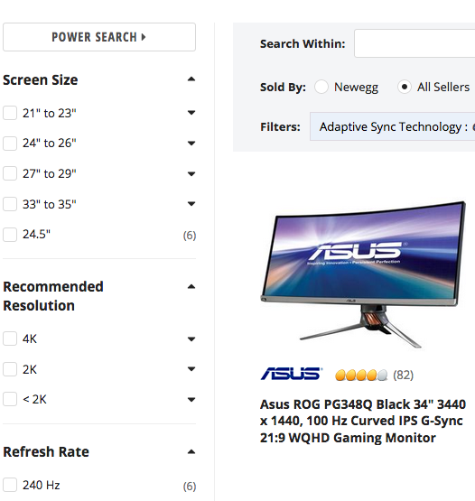
Filters and Facets on newegg.com
Filters
Faceted Search

Slide 8
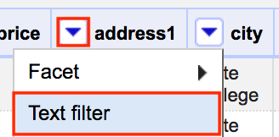
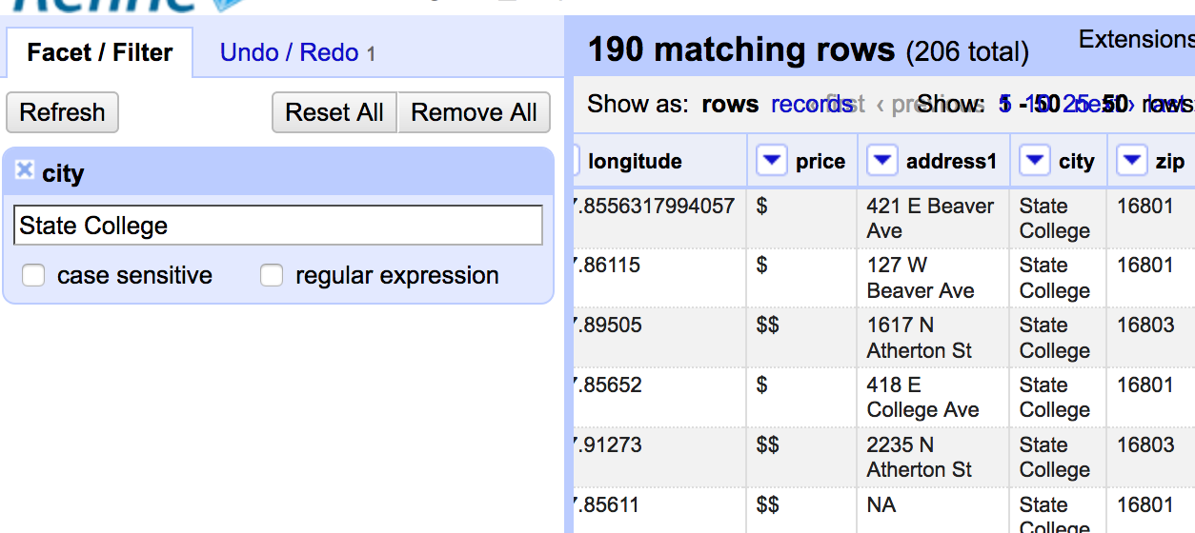
Adding a text filter
Show only rows with
“State College” as part of
entry
Number of
Matching rows

Slide 9
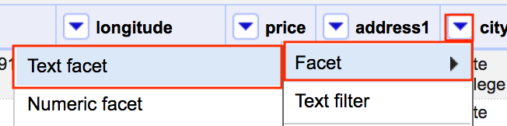
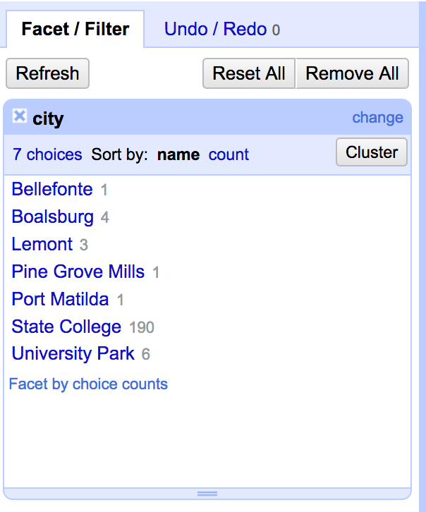
Exploring Data with Text Facets
Click to facet on label(s)
All unique categories
Number of rows

Slide 10
Malone wants dinner! Exercise 2 - Exploring Textual Data
Tasks: Use text facets to explore
isclosed
price
rating
Let’s Eat!

Slide 11
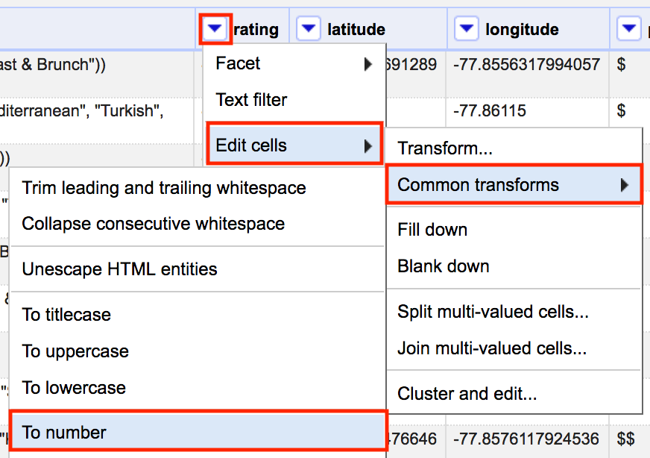
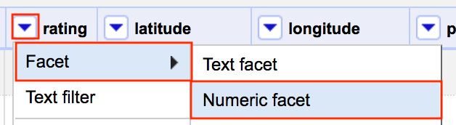
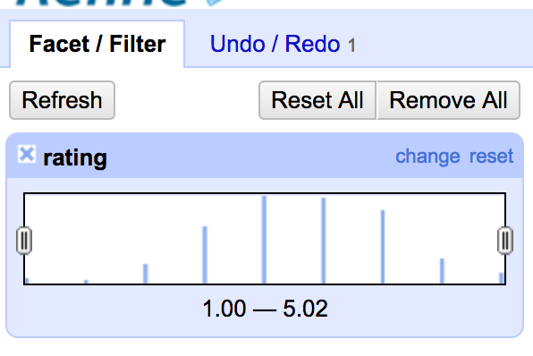
Numeric facets

Slide 12
Malone wants dinner! Exercise 3 - Exploring Numeric Data
Tasks: Use numeric facets to explore
rating
review_count
Let’s Eat!

Slide 13
Timeline facet
Note: We need to clean the years before we can do this.

Slide 14
A Good Practice Narrow Early, Narrow Often
Whenever possible, narrow the data by
Select the columns
Filter/Facet the rows

Slide 15
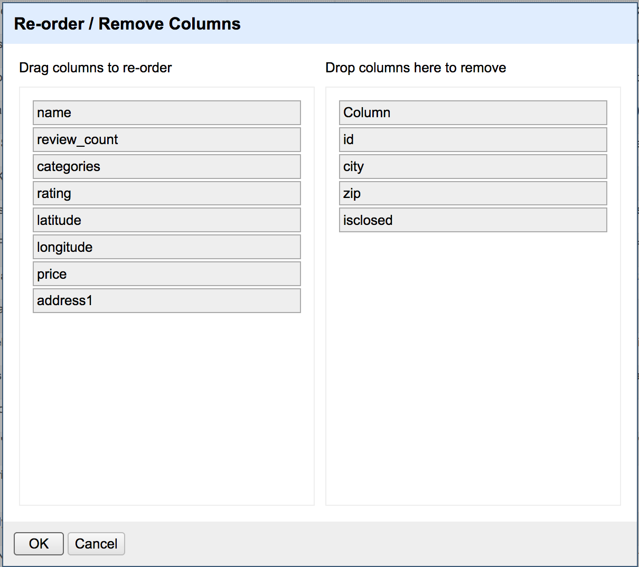
Selecting columns

Slide 16
Malone wants dinner! Exercise 4 – Narrow the data
Tasks: Use filters/facets to narrow to
State College
Rating of 3.5+
review_count >= 10
Let’s Eat!

Slide 17
Other reasons to filter/facet
Filter
Facet
Does a pattern exist?
How many times?
Advanced: Transform certain rows
First filter
Then apply a transform
See all labels together
Select multiple labels at once
And possibly transform
Double check clustering outcome (see below)

Slide 18
Mutate in OpenRefine
Three common transforms to clean textual data
Use a text facet edit individual labels
Use cluster and edit find similar labels
Use transform to split and replace text

Slide 19
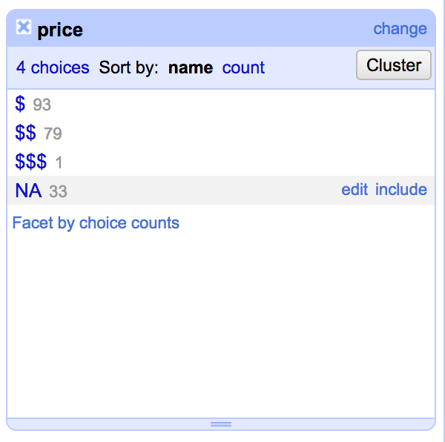
Using a facet to edit labels
Click edit to
change ALL
instances at
once

Slide 20
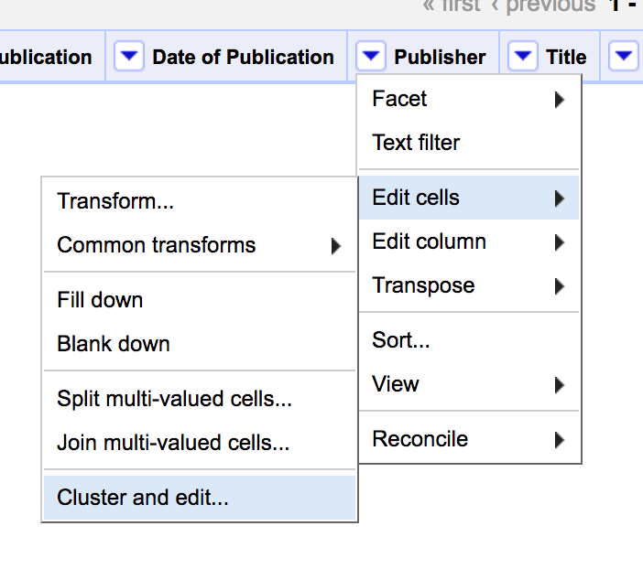
Cluster and Edit
Clustering algorithm
Similar labels
New label goes here

Slide 21
GREL Expressions
GREL
Common Uses
Google Refine Expression Language
Two formats
value.func(args)
func(value, args)
Perform a computation
e.g. change units
Splitting text
Extract pattern or datepart

Slide 22
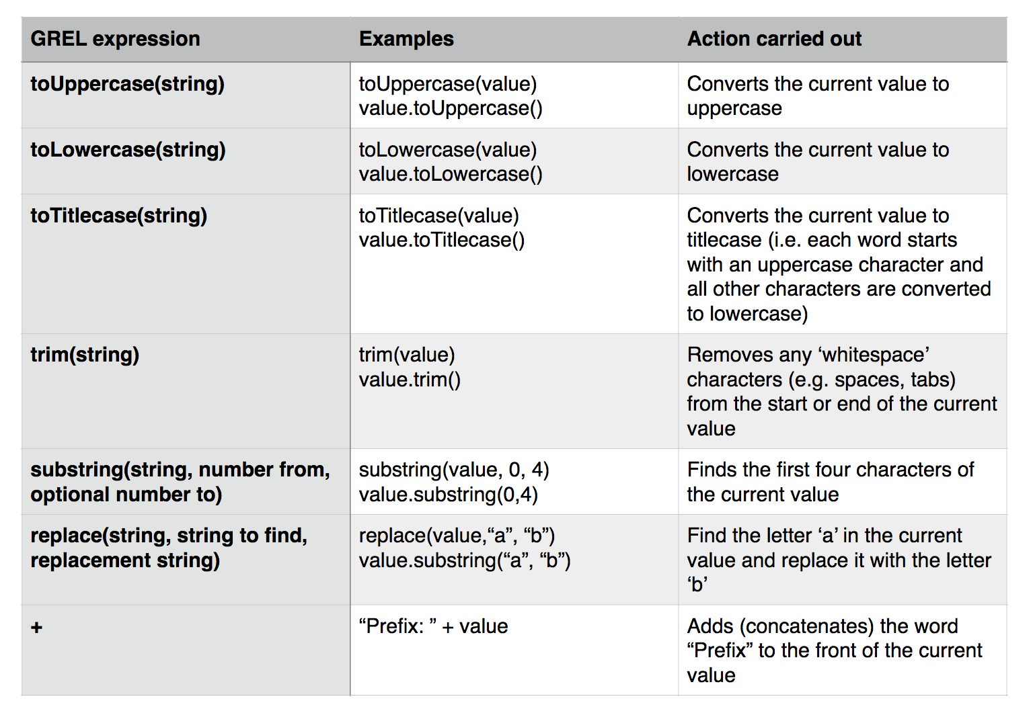
Some simple transformations
Image source: OpenRefine documentation

Slide 23
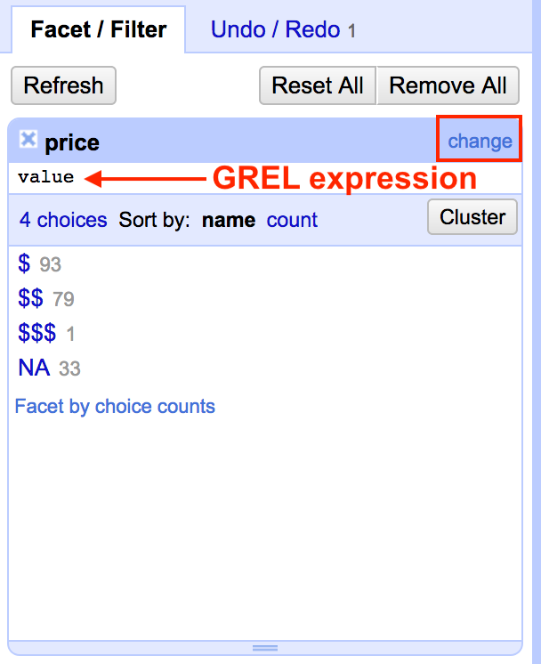
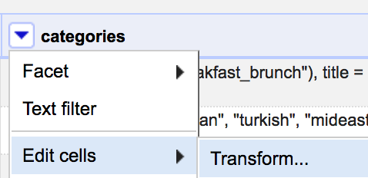
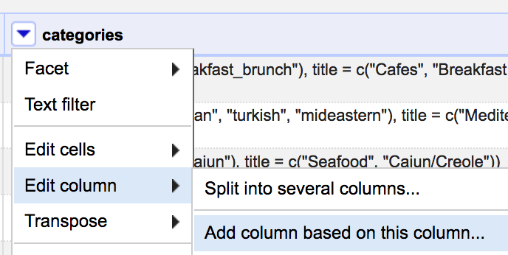
Three Way to Transformation
From Facet
In Place
Create a New Column

Slide 24
Malone wants dinner! Exercise 5 – Form a strategy for extracting the titles from categories
Tasks: Form into teams and develop a strategy.
Let’s Eat!

Slide 25
Our Strategy
Malone’s strategy
Iverson’s strategy
Let’s eat!
Remove the stuff at the front
Remove parentheses and quotation marks
Replace title = with |

Slide 26
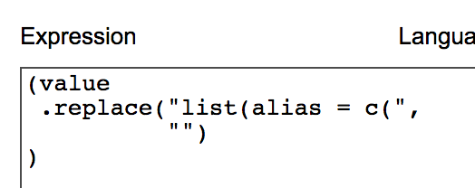
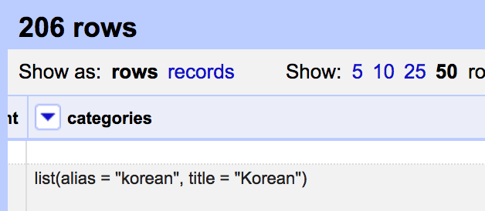

Removing the stuff at the front Attempt 1

Slide 27
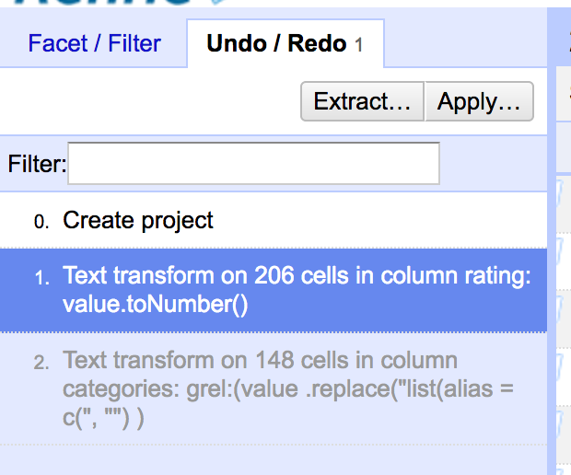
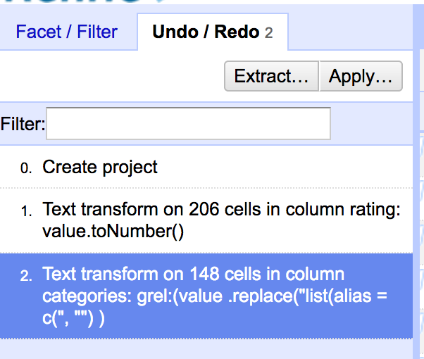
The true power of OpenRefine
Undo
Redo
It’s a FREAKING TIME MACHINE!!!1111!!!one!1!

Slide 28
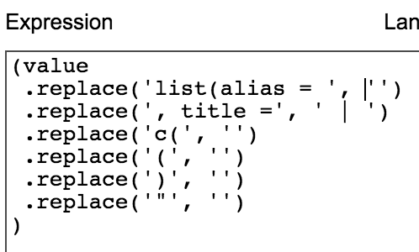
Malone wants dinner! Exercise 6 – Cleaning up categories
Tasks: Perform the following transformations
Undo the last attempt
Remove/replace stuff
Remove stuff at the front
Replace c(, ), and "
Replace , title = with |
Let’s Eat!

Slide 29
Indexing in GREL
-9 -8 -7 -6 -5 -4 -3 -2 -1
H
e
l
l
o
B
o
b
0 1 2 3 4 5 6 7 8

Slide 30
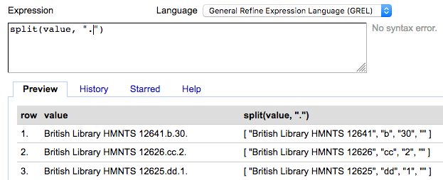
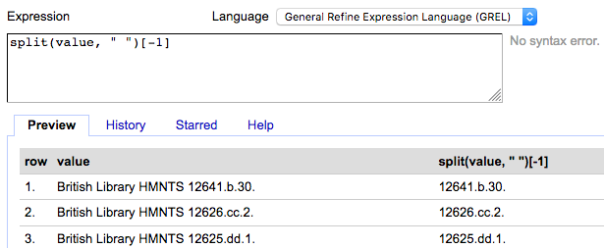
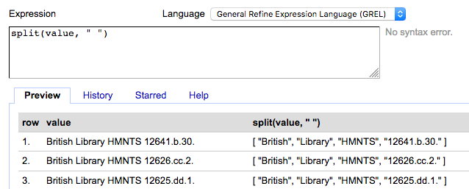
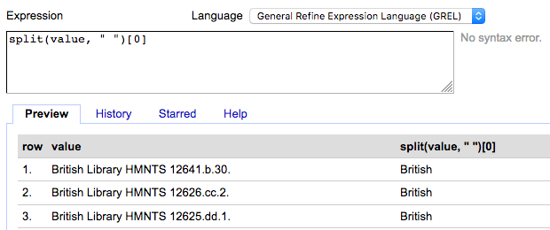
Splitting strings with split
Splitting on "."
Pulling off the substring
Splitting on " " (space)
Pulling off the first substring

Slide 31
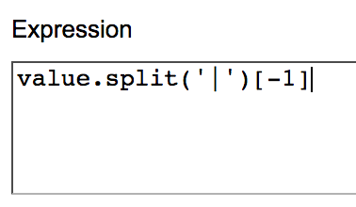
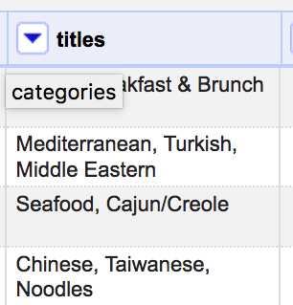
Malone wants dinner! Exercise 7 – Extract the category titles with split
Tasks: Use split and indexing to extract the titles.
Hints:
The titles are after the |
You should make a new column called title
Let’s Eat!

Slide 32
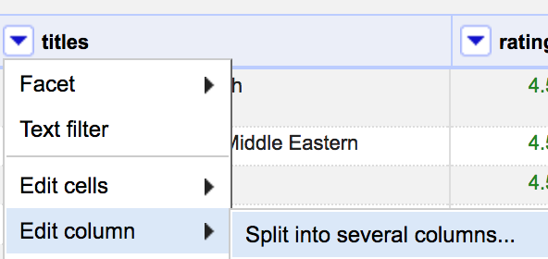
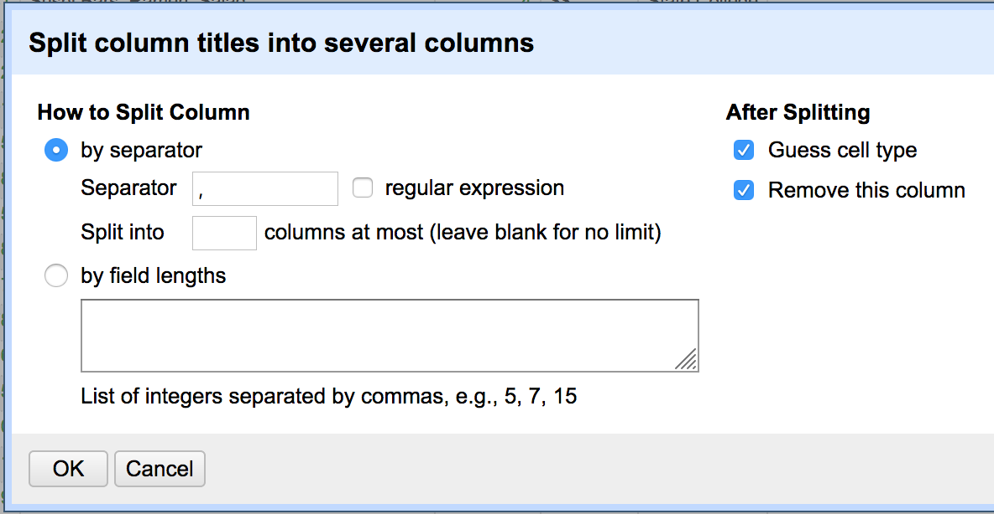
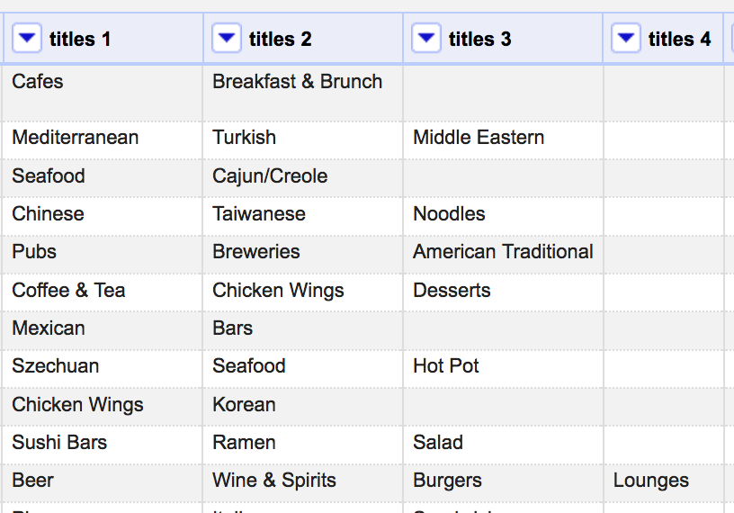
Malone wants dinner! Exercise 8 – Split the titles into separate columns
Tasks: Split the titles into multiple columns
Use defaults
Let’s Eat!

Slide 33
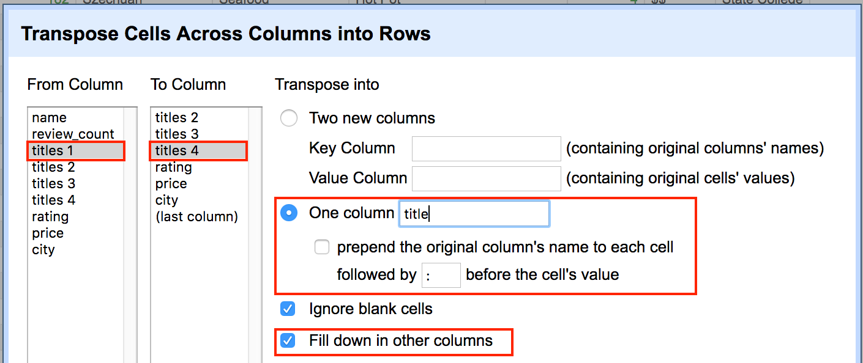
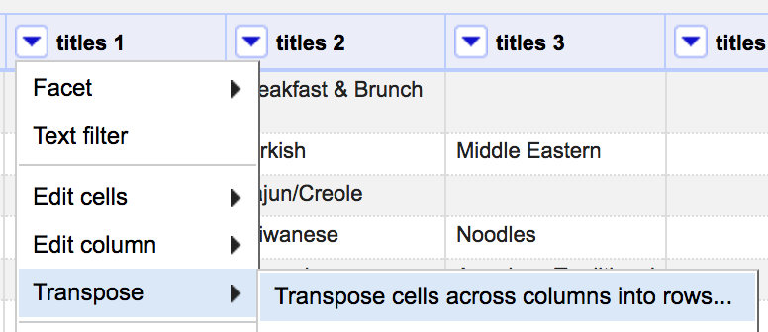
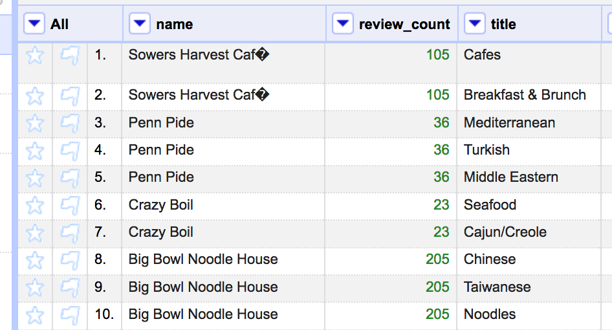
Malone wants dinner! Exercise 9 – Transpose the titles
Tasks: Stack the titles into one column
Let’s Eat!

Slide 34
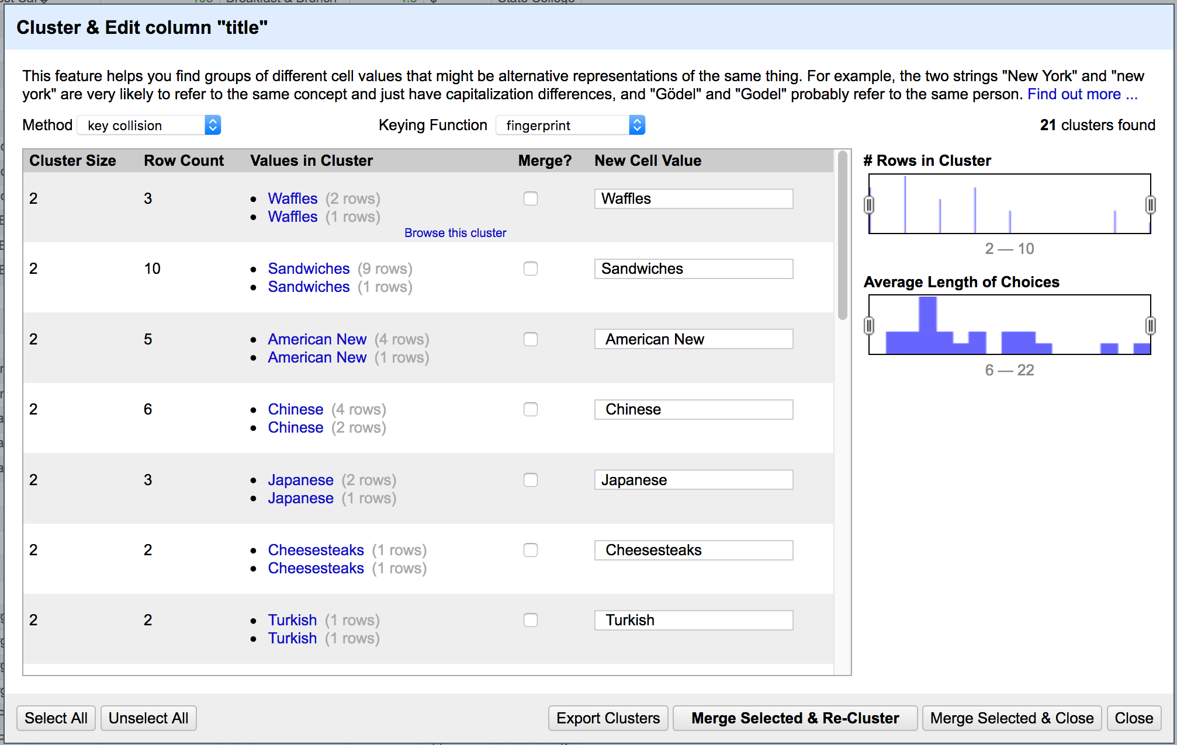
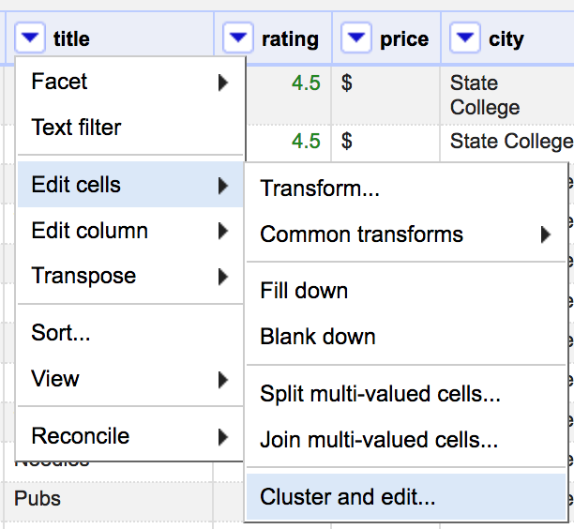
Malone wants dinner! Exercise 10 – Find a place to eat
Tasks: Cluster and edit the new titles column
Let’s Eat!

Slide 35
Malone wants dinner! Exercise 11 – Find a place to eat
Tasks: Use filters/facets to narrow your options and pick a place to eat!
Let’s Eat!

